Slide 1
Nursing Leadership: Global Contexts and Connections
Western/Prairie Regional Conference 2015
Canadian Nursing Students’ Association
Nora Whyte, RN, MSN

Slide 2
Dedication – Verna Huffman Splane
International nurse, leader, mentor and friend.
Served as VP on the Board of Directors of ICN from 1973 to 1981.
Worked for WHO and Canadian Govt.
Officer of the Order of Canada
Photo: Verna addressing a group of Canadian nursing leaders at a garden party at her home [CNA Biennium in Vancouver June2012]

Slide 3
Outline
Inspire: How I have been inspired through involvement in global nursing partnerships.
Advocate: Examples of advocacy in action.
Unleash: The power of the profession in realizing change through global citizenship – International Council of Nurses & New Global Agenda of the UN Sustainable Development Goals.

Slide 4
My journey in global nursing

Slide 5
Building blocks
Early career: Community health roles in rural Manitoba and in urban South Africa.
MSN with a clinical specialty in CHN followed by teaching at UBC.
Connections with Global Health initiatives in BC.
Worked for Provincial Nursing Association: RNABC
Launched independent consulting practice 21 years ago: PHC Consulting.
Contracts in planning, managing and evaluating health & nursing projects in BC and internationally.
Study tours & conferences provided inspiration.
Flexibility to juggle local and global work.

Slide 6
Learning & connecting through partnerships
Nursing Association of Nepal & Canadian Nurses Association
Japanese Nursing Association
Canada-India Education Society & UBC Nursing & Guru Nanak College of Nursing & Baba Farid University of Health Sciences in India

Slide 7
Nepal
Long-term partnership over 7 years to rebuild a national nursing association in the 1990s
Supported by CNA’s International Program to strengthen nursing associations--with funding from the Canadian Govt.
Capacity development for NAN Board and nursing community

Slide 8
Outcomes
Infrastructure developed & sustained
Nursing networks in rural areas
Continuing education
Nursing journal
Advocacy on health issues
Links with other civil society organizations

Slide 9
Community Outreach & Volunteerism

Slide 10
International Nursing Day 2014

Slide 11
Japan
Worked with Japanese Nursing Association and nursing schools on health promotion & community development projects
Organized study tours to Canada x 5
Collaborated on publications & seminars

Slide 12
Context
New roles for public health nurses
Strong interest in services for seniors
Teamwork by nursing leaders to contribute nursing knowledge to health system reform

Slide 13
Demonstrating community meeting process in Miura City hosted by JNA

Slide 14
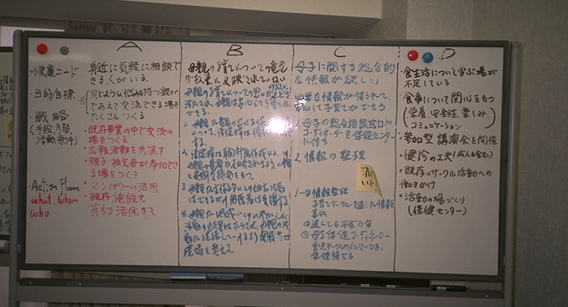
Results of Miura City Meeting – “Guidebook for community meetings”

Slide 15
Nagano College of Nursing

Slide 16
India

Slide 17
Canada-India Partnership
Faculty development in moving to a BSN Degree Program in 1998. University of BC School of Nursing was asked to become a partner with Canada India Education Society in working with Guru Nanak College in Punjab.
Faculty & student exchanges took place from 1998 to 2007.
Canadian partners assisted with lab and library resources.
Primary Health Care Project was created in 2001to build on the growing relationship—carried out from 2001 to 2005.
New partnership with Health Sciences University in Punjab began in 2012.

Slide 18
Student Exchanges
Bilateral exchanges.
Small groups of students each time.
Benefits to other students in both schools (buddies & group learning).
Leadership & relationships.

Slide 19
UBC students making connections

Slide 20
Faculty Exchanges

Slide 21
Partnership Models
Value of long-term partnerships with time to gain understanding of culture, history & politics of each partner country/region.
Student exchanges (undergraduate and graduate levels) within the context of the partnership. What are the challenges and benefits?
What are some other avenues in international engagement and advocacy for global health?

Slide 22
Building Capacity for Primary Health Care in Rural Punjab
Focus on PHC approach using community development, prevention & health promotion in rural areas
Exploration of community health nursing role
Leadership for health improvement
Partnerships with local organizations

Slide 23
Phase 1: Community Assessment
60 villages
Held community meetings
Compiled report with recommendations
Used report to develop proposal for Phase 2

Slide 24
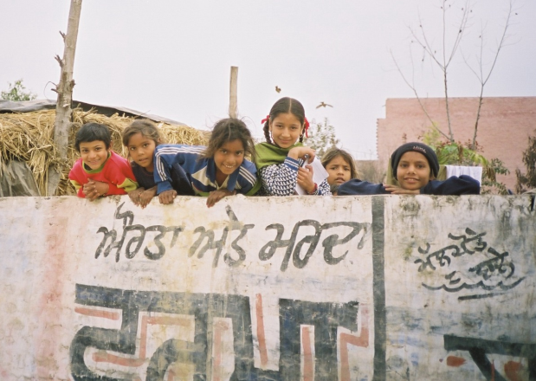
Assessment Process
Faculty & nursing students surveyed 9,600 households
Assessed village environment, sanitation, health conditions & services

Slide 25
Phase 2: Village health services
Team of CHNs began delivering health programs: Women’s groups, school health, maternal-child services & health promotion in selected villages.
Canadian consultants supported the team, worked on organizational development with partner & monitored progress.

Slide 26
CHNs leading change
CHNs established relationships with local leaders.
Held village meetings to explain the purpose of the new project; gained experience in organizing meetings and events.
Responded to community concerns and requests for new services (e.g., requests from schools).
Worked with a group of volunteers to help organize outreach.
Linked with local organizations on new projects (e.g., reproductive and maternal health).
Evaluation: Access improved & satisfaction with services was high.

Slide 27
Health Fair

Slide 28
Village Environments

Slide 29
“Healthy Mothers, Healthy Babies”

Slide 30
International Council of Nurses
130 national nursing associations, including Canada (CNA)
16 Million Nurses
Advocacy
Congresses & Conferences
Networks
Leadership Activities

Slide 31
Judith Shamian, President 2013-2017
ICN promotes quality nursing care & sound health policies globally
Connected to other international bodies (WHO, International Labour Organization)

Slide 32
ICN Student Assembly - 2013

Slide 33
Delegates at ICN Congress – Durban 2009

Slide 34
ICN 2015 Conference
Keynote Speaker
Sheila Tlou
Nursing leader with global presence
Former MP & Minister of Health, Botswana
Current position: Director of the UNAIDS Regional Support Team for Eastern and Southern Africa

Slide 35
Sustainable Development Goals
“Transforming our World: The 2030 Agenda for Global Action” approved by UN General Assembly September, 2015
17 Broad Goals
# 1. End poverty
# 3. Ensure healthy lives
# 5. Achieve gender equality
# 13. Take urgent action on climate change

Slide 36
Goals & Targets for Health
All 17 goals link to determinants of health. Each goal has specific targets.
Health is recognized as a fundamental human right.
New emphasis on health systems and human resources for health.
Universal health coverage is viewed as a key target and opportunity for greater advocacy by health activists.
Universal health coverage includes financial risk protection, access to essential services plus access to safe, effective, affordable medicines and vaccines for all (Target 3.8).

Slide 37
New Contexts & Opportunities

Slide 38
References
United Nations Sustainable Development Goals
BC Council for International Cooperation “Keeping score: UN Sustainable Development Goals”
[Note relevance to Canada and closing gaps for Aboriginal populations]
WHO “Investing in health workforces: the path towards the SDGs starts here” (Jim Campbell)
Canadian Nurses Association: International Work
[See this page for resources on Programs & Partnerships, Global Health Issues and ICN]

Slide 39
Engagement & Career Opportunities
Canadian Association for International Nursing
Canadian Council for International Cooperation
Canadian Red Cross
Canadian Society for International Health
CUSO International
Doctors Without Borders (MSF)
International Council of Nurses
OXFAM Canada

Slide 40
Closing Comments...
Nurses and their organizations—associations, unions & schools of nursing—exemplify leadership in multiple ways:
Commitment to improving health & health care
Local and global citizenship
Passion for the profession
Teamwork to achieve their goals
Strategic partnerships and coalitions
Solidarity and advocacy for change

Slide 41
Appreciation
Nursing Association of Nepal
Japanese Nursing Association
Guru Nanak Trust, Baba Farid University, CIES & UBC School of Nursing
CNA & ICN
CNSA!
My mentors and networks

Slide 42
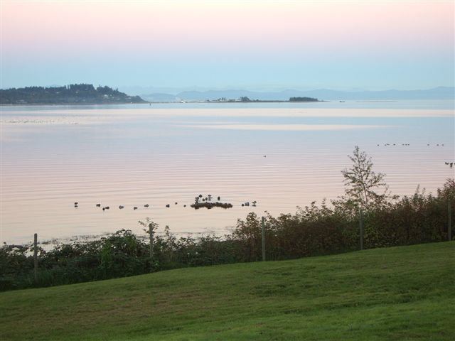
Contact Information
PHC Consulting
nwhyte@shaw.ca

